Slide 1
Generating molecules with interesting properties from SMILES strings
Martijn Oele
Dr. ir. B. Ensing
Y.A. Ran MSc
Machine Learning in Chemistry
27-5-2024

Slide 2
Content
introduction
Method
Results and discussion
Conclusion

Slide 3
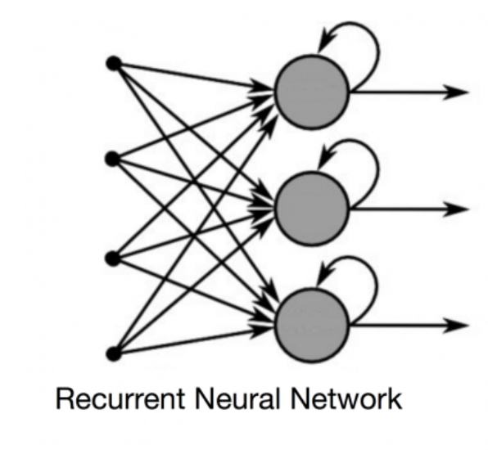
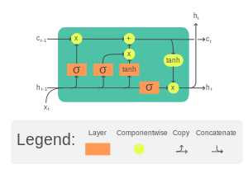
Introduction - RNN
Sequential generation
Retention of past information
Natural language
Translation
Music
LSTM
Hochreiter and Schmidhuber in 1997
Long term memory (cell state c)
Short term memory (hidden state h)
Gupta et al. Mol. Inf. (2018)

Slide 4

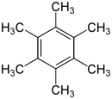
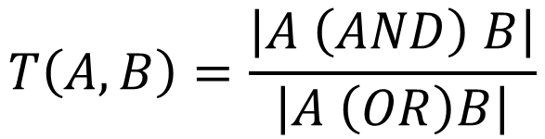
Introduction – Properties
Proof of concept via RDKit
Logp (partition coefficient)
MACCS fingerprint
Tanimoto similarity score
Using neural networks to assign properties
Bioactivity
Solubility
Using actual (quantum) calculations
Not enough information in SMILES
Conformation of molecule
Logp = -0,81 logp = 4,61
$$T\left(A,B\right)=\frac{\left|A \left(AND\right) B\right|}{\left|A \left(OR\right)B\right|}$$
SMILES
NN
Prediction of property
Olivecrona et al. J Cheminform (2017) & Pereira et al. J Cheminform (2021)

Slide 5
Introduction – Reinforced learning
RL training
RNN
Scoring of generated SMILES
Reward/penalty used to teach the model
Many ways to score
Used to generate SMILES with preferred properties
Bioactivity
Low sulfur content
Alternative to bias during training
Similar molecules / properties
Balance between exploration and exploitation
Sample
Scoring
Olivecrona et al. J Cheminform (2017) & Pereira et al. J Cheminform (2021) & Gebauer et al. N communications (2022)

Slide 6
Method – Model
LSTM 1
In: n unique tokens
Out: 256 hidden features (h)
Training
Dropout
0,5
LSTM
Two layers
Input number of unique tokens
256 hidden features (h)
First 0.5 and second 0.3 dropout
Linear
Input size of 256 (hidden LSTM)
Output number of unique tokens
SoftMax (only sampling)
Multinomial
LSTM 2
In: 256 hidden features (h)
Out: 256 hidden features (h)
Dropout
0,3
Linear
In: 256 hidden features (h)
Out: n unique tokens
SoftMax
Multinomial
Gupta et al. Mol. Inf. (2018)

Slide 7
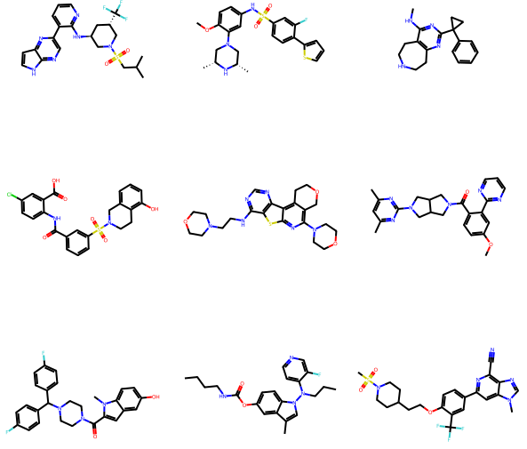
Method – Dataset
ChEMBL 22 (2016)
Open access
542 673 (canonical) SMILES
34 – 74 characters
No salts
IC/EC50 and kd/ki/b
Bioactive molecules
Used in drug discovery
https://www.ebi.ac.uk/chembl/

Slide 8
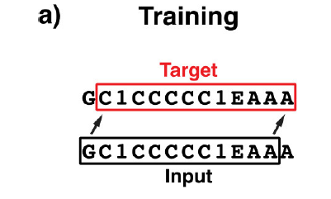
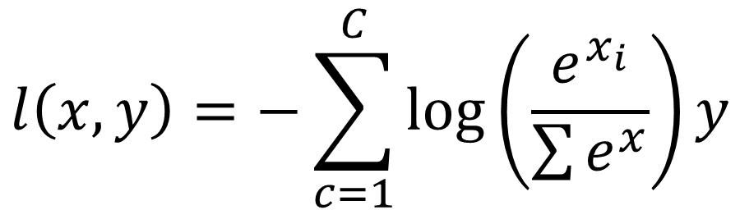
Method – Training
Adam optimizer
AdaGrad
Adaptive learning rate
RMSProp
Stabilizes learning rate
CrossEntropyLoss loss function
SoftMax function
$$l\left(x,y\right)=−\sum_{c=1}^{C}{\log\left(\frac{e^{x_{i}}}{\sum{e^{x}}}\right)y}$$
Gupta et al. Mol. Inf. (2018)

Slide 9
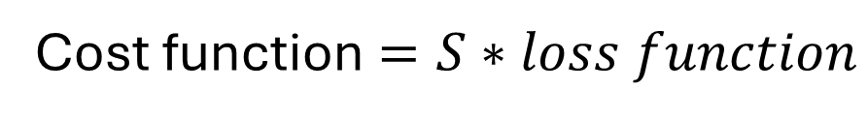
Method – Reinforced training
Reward preferred properties
Penalty for large loss
Generate SMILES
Score the smiles based on property
Calculate reward/penalty
Based on complete (valid) SMILES
Not rewarded on a token level
Cost function $=S∗loss function$
Logp {0,5 : 1,5}
S = Scaled(target – prediction) + 0,5
MACCs Tanimoto {0,5 : 1,5}
S = 1 - Tanimoto + 0,5
Olivecrona et al. J Cheminform (2017) & Pereira et al. J Cheminform (2021)

Slide 10
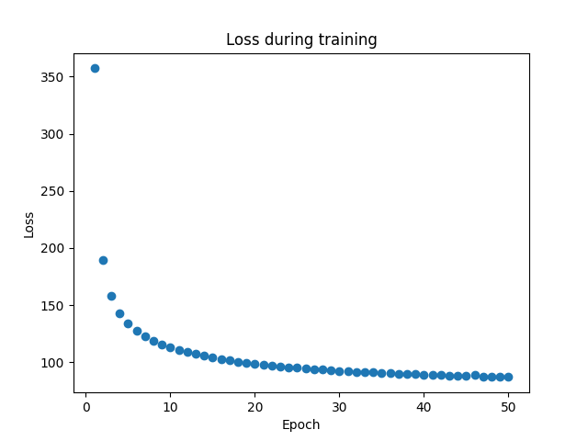
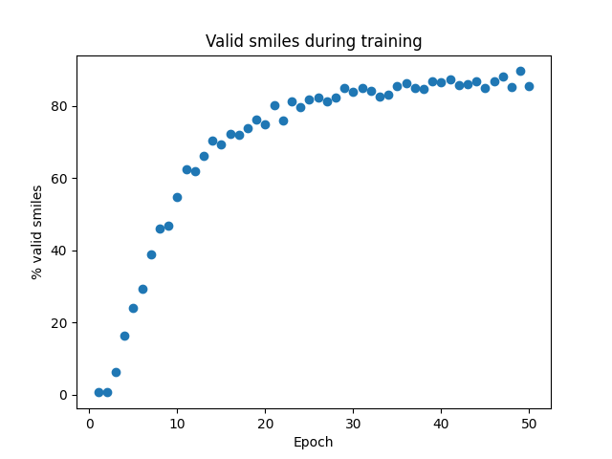
Results and Discussion – Training
50 epochs
Batch size of 1536
Learning rate of 0,001
Approximately 2.5 hours (CUDA)
5,5 GB VRAM

Slide 11
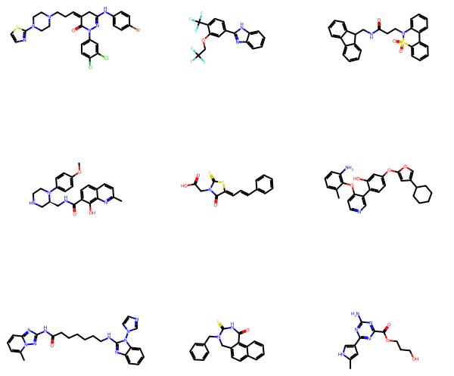
Results and Discussion – Sampling
~85% valid SMILES (n=10 000)
Temperature of 1.
Literature 22 epochs
~70% valid SMILES @ T=1,2
~98% valid SMILES @ T=0,5
2 sec to sample 1 000 smiles
Hidden and cell state (h and C)
Passed during the sequencing
Passing between sequences gave empty string
Gupta et al. Mol. Inf. (2018)

Slide 12
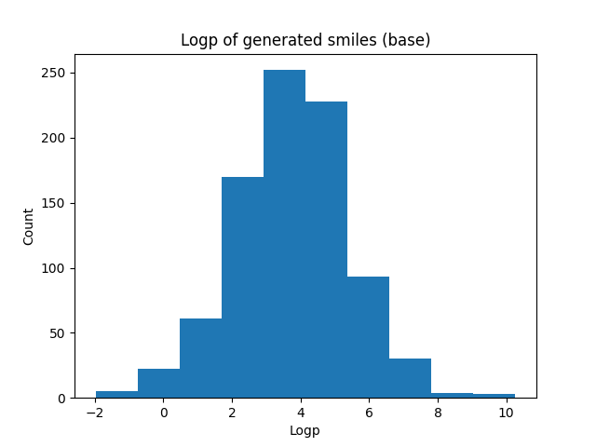
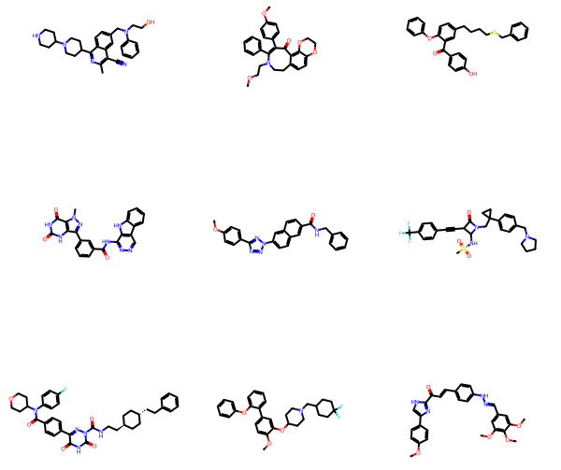
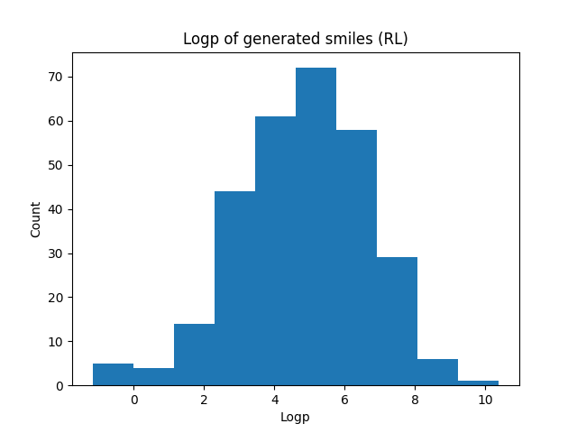
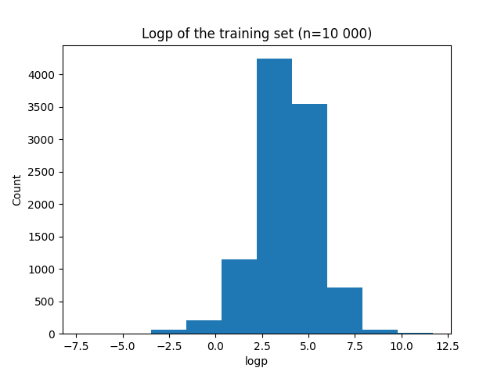
Results and Discussion RL logp
Reinforced learning
Target logp = 6
20 iterations
Learning rate: 0,000 01
Generate 1 000 SMILES
10 epochs
Multiply loss times a penalty
Between 0,5 and 1,5
Scaled
Valid smiles drops ~30%
Sensitive to learning rate
Can be further optimized

Slide 13
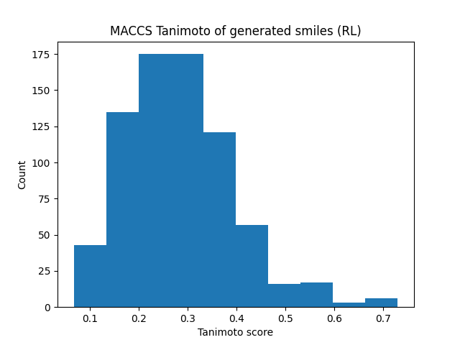
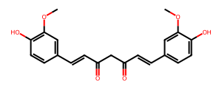
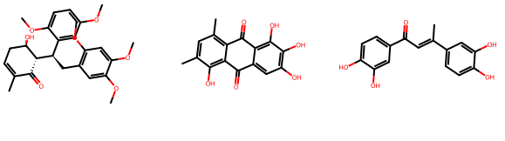
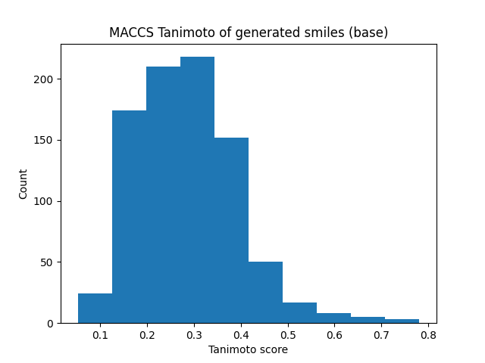
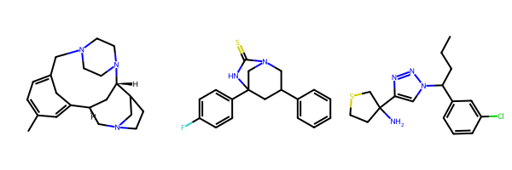
Results and Discussion RL MACCS / Tanimoto
Nearest neighbor
Furthest neighbor
Curcumin
50 iterations
Learning rate: 0,000 001
Generate 1 000 SMILES
10 epochs
Tanimoto score
between 0.5 and 1.5
1 – score + 0,5
Valid smiles stable ~75%
Sensitive to learning rate
Can be further optimized

Slide 14
Conclusion
LSTM RNN can be used to sample (valid) SMILES
Post training with (new) target data has been used
Drug discovery
Reinforced learning
Our implementation didn’t work as expected
Unclear in article how the rewards were calculated {0,1}?
Other reward system
Add penalty
Larger range of the penalty/reward
Not possible without CUDA acceleration

